Slide 1
KV6002 Week 5 – Testing
Dr Rebecca Nicholson

Slide 2

KV6002 Team Project and Professionalism – Week 1
Today I will:
1. Go through testing options (briefly).
2. Cover ways of carrying out human-centred evaluations.
3. Give some tips for how to present this.

Slide 3
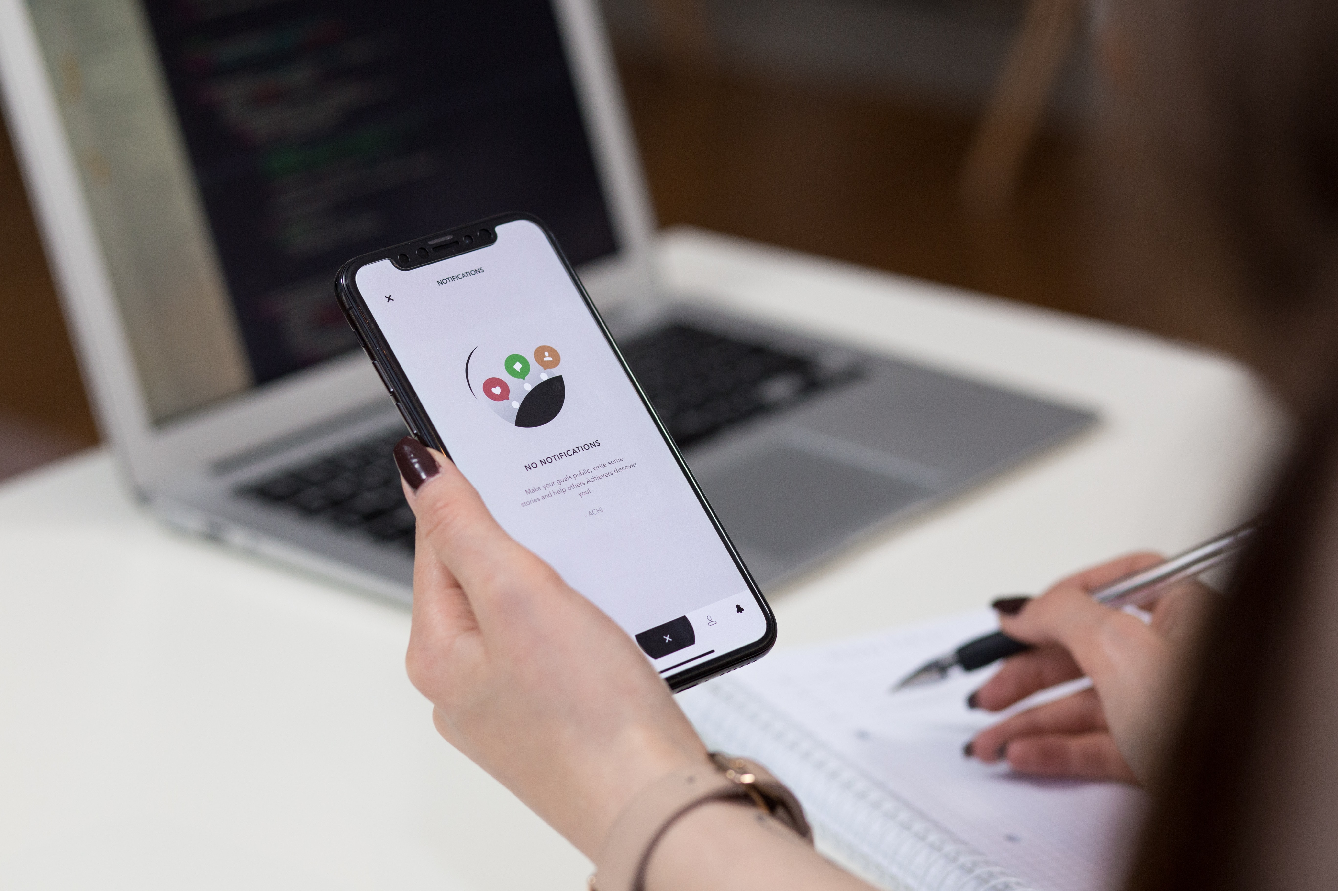
Testing
Testing is a necessary part of any software development cycle.
How you do this depends on what you are developing / you chosen methods.

Slide 4
Effective Testing
Multiple possible methods for software development testing.
Not going to go through them all in detail.
You should be testing your code and should have a testing plan.

Slide 5
Best Practice
Test early, and test often.
Continuous testing – you should be testing throughout the development process.
Bug reporting / tracking – you should have some way of tracking identified issues.

Slide 6
Testing Options
Unit testing,
Functional testing
Integration testing
Stress testing
Usability testing

Slide 7
Unit Testing
Probably the most common – do the individual elements run without bugs / errors.
Given the size of projects – manual testing is probably enough, however consider whether you might save time automating any of it.

Slide 8
Functional Testing
Testing business requirements – does it do what you intended it to do?
This should be done in relation to your initial requirements. Have you implemented all aspects of the

Slide 9
Integration Testing
Testing how well features integrate – do the added features function when added?
This should be at the forefront of your testing plans given how we’ve asked you to work.

Slide 10
Stress Testing
Testing how well the system works under pressure – will it work with the imagined number of users?
This is a consideration and may vary depending on your client’s use case.

Slide 11
Usability Testing
An often missed step – is it usable by someone.
This is a central aspect of testing for ALL systems!

Slide 12
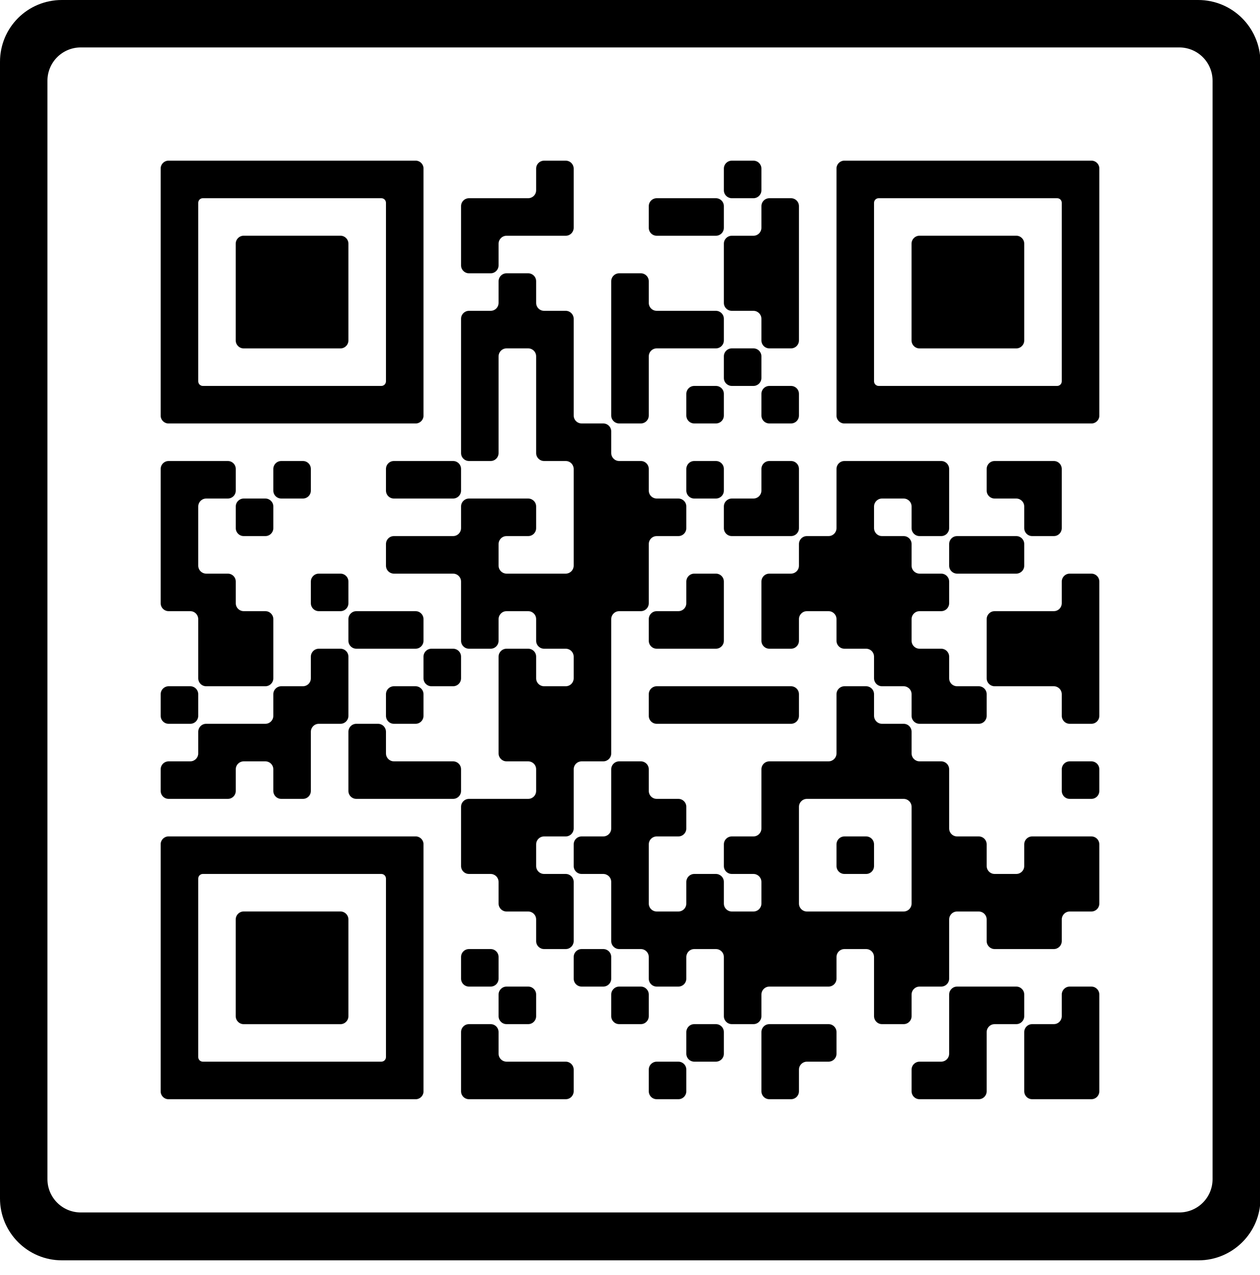
Why usability testing?
https://userinyerface.com/

Slide 13
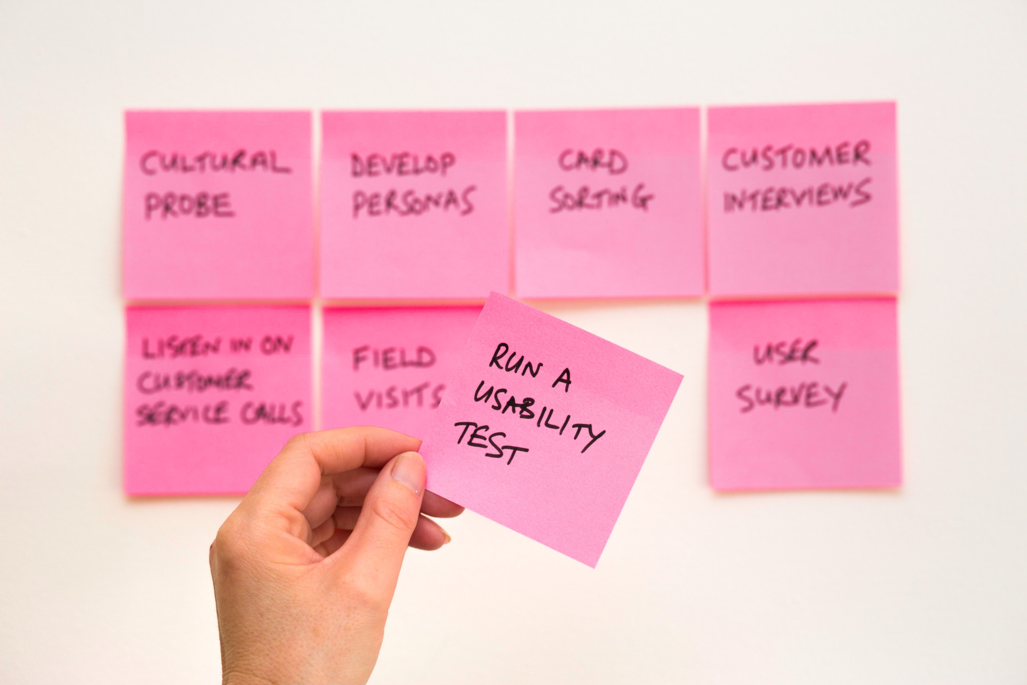
Human–Centred Evaluation
Hugely important step.
In this project you are expected to go back to the client to ask for feedback on your designed project.

Slide 14
Possible Options
1. Demo the system to your client (hands off approach).
2. Ask your client to try the system (hands on approach).

Slide 15
Demo to your client
Things to think about:
How will you demo the functionality
What questions will you ask
How will you determine if the feedback is ‘good’?

Slide 16
Client tries the system
Things to think about:
How will you ensure they’ve tried all functionality?
Will you ask them questions?
How will you get ‘feedback’?
What feedback do you want from them?
How will you determine what is ‘good’ feedback?

Slide 17

Including the feedback in your demo
Make sure you include this.
Will you write down the feedback?
Will you ask your client to provide some?

Slide 18
Client Feedback in Demo
Things to make clear:
What was the purpose of your client feedback? What were they testing?
How did you measure the feedback against this aim?
What were the results?
Try and present it as systematically as you can.

Slide 19
Demo / Recording
Next week I will cover:
Assignment 2 requirements
Recording demos – how to / possible tools

Slide 20
Week 5 expectations.
As a minimum you need to have:
Made a start on your tasks
Created a testing plan
Got a clear task list (with dates and who is responsible)
Make plans for ensuring you address your agreed upon targets / areas for improvement.

Slide 21
Questions?

